Slide 1

OBJECT AVOIDANCE ROBOT Team: Star-Force
Team Members: Guided by:
Avinash Bhat Benjamin Staehle
Bhuvan Harlapur

Slide 2
Objective
Star Force robot is taking on the daunting task of reaching its designated goals and earning maximum reward in an Gazebo environment filled with obstacles and other robots also competing to reach the goals.
Star Force robot is given reward points for reaching each goals which are different for each goal

Slide 3
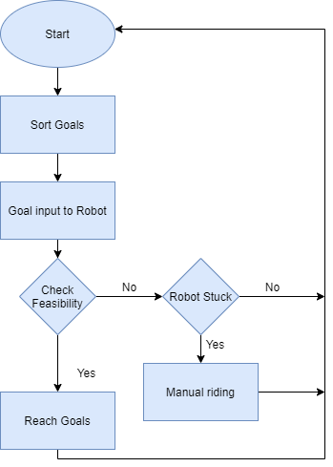
Flow Chart

Slide 4
Goal Sorting
Goals are taken from /goals and saved into a list.
Take value of current position of the robot from gazebo/model_states
Calculate Euclidean distance of robot from current position to each goal point and append it to a list
Calculate Reward per unit Distance for each point from the robot position.
Sort the goal in descending order of Reward per unit Distance
Publish the sorted goals to the custom topic /star_goals created by our team
This sorting logic is used to make sure for every unit distance the robot travels it gains maximum rewards.

Slide 5
Goal Reaching Logic
Sorted goals are subscribed form /star_goals topic and provided to /move_base package.
The status of the robot is continuously being check form the /move_base/staus topic.
If the status is changed to 3, the goal is reached and again goal sorting logic is run and best goal is provided to the robot.
This logic doesn’t work for all the goals as few goals are harder to reach and some may be impossible to reach.
The goal reaching logic keeps also running another logic called Check feasibility to make sure the robot can take better decision in terms of the way the robot achieves the goals

Slide 6
Check Feasibility
In this step the robot checks if the goal is reachable or not.
Here we continuously monitor the position of the robot from the topic /amcl_pose.
The robot while travelling towards goals is checked If it is stagnant for more than thirty seconds.
If the robot is stagnant, the distance between the robot and the goal is calculated at that stagnant position.
If the is less than 0.2 then the goal is considered to be Reached and the robot moves to the next goal.
Continuous checking is achieved from the function ‘threading.Timer’

Slide 7
Manual Riding
There is a possibility that while moving towards a goal the robot might get stuck.
If the robot gets stuck the move_base package is aborted and status is turned to 4.
When the status changes to 4 the robot moves into manual driving.
The robot takes in the scan data to check for free space.
The robot moves toward free space an frees itself by giving suitable velocity values to /cmd_vel.
Once the robot is free, it again moves towards the remaining goals.

Slide 8
Things We tried
Move Base Parameters.
Inflation Radius- Not Achieved.
xy_goal_tolerance – Changed to 0.2
yaw_goal_tolerance – Changed to 6.28
Retrying lost goals - Not Achieved
Generating of test files for our packages-Achieved.

Slide 9
THANK YOU
Any Questions ?

